Slide 1



Template Slide #1
POC
Credit Card Activation using Chatbot March 2018
Copyright © 2018, Oracle and/or its affiliates. All Rights Reserved. | Confidential – Oracle Internal
Notes:
.

Slide 2
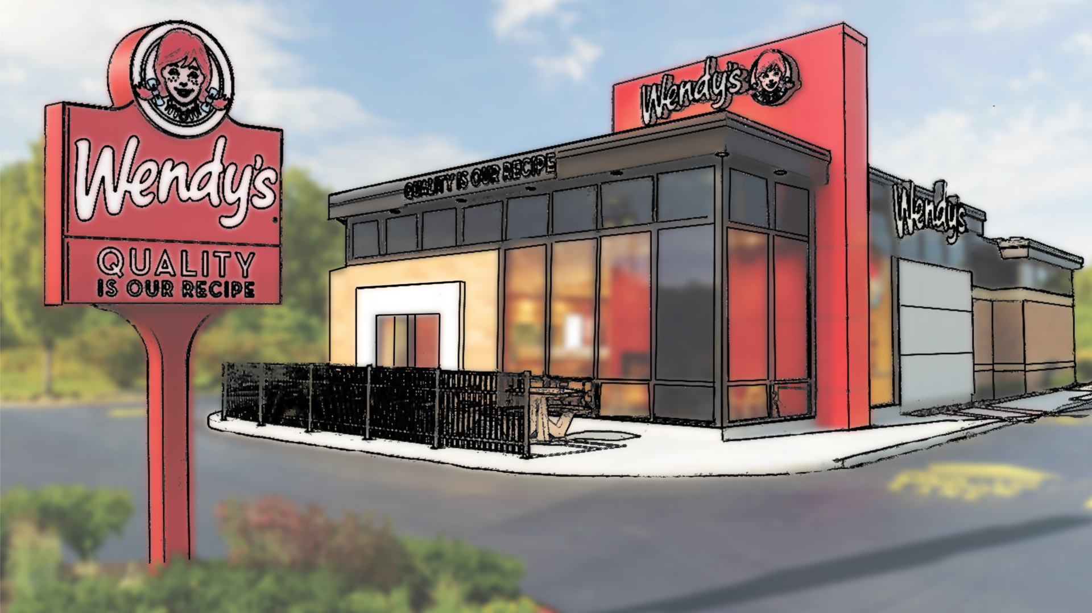
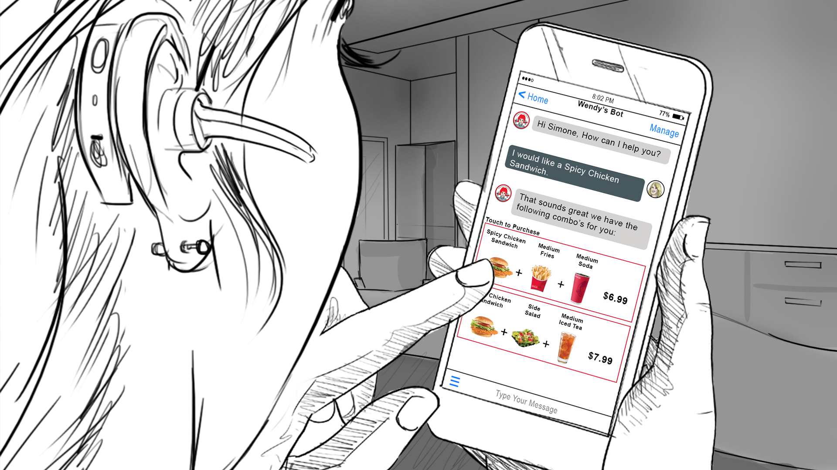

Example
Fast Food Restaurant
FastFoodBot
Fast Food Ordering using Chatbot December 2017
POC
Copyright © 2018, Oracle and/or its affiliates. All Rights Reserved. | Confidential – Oracle Internal
Notes:
.

Slide 3







Solution Highlight
Credit Card Activation Chatbot
Go to the Solution Bank Asset Page
Insert business solution images in this space. Use images to tell a customer story at a very high level. Note: The full story is not needed here – just enough to represent the solution.
Go to the Asset Folder in ODocs
Watch the Solution Prototype Video
Use one to three English sentences here to describe the business problem or desired solution/capability, how Oracle’s solution innovatively addresses this need using cool technology, the Oracle solution differentiation, and its value to customers.
Lead ECA Name
Lead Developer Name
Provide the high-level Notional Architecture of Solution in this space. Make sure the Notional Architecture tells the use case story of Actors interacting with systems, the flow of information, and high-level technology components/applications and interactions. Note: It is not necessary to show the individual cloud services.
Cloud Developer Name
Cloud Developer Name
Copyright © 2018, Oracle and/or its affiliates. All Rights Reserved. | Confidential – Oracle Internal
Notes:
.

Slide 4





Example
Solution Highlight
Fast Food Ordering Chatbot
Fast Food Restaurant
FastFoodBot
Go to the Solution Bank Asset Page
Go to the Asset Folder in ODocs
A bank or a credit union needs to transform business by using modern social channels to increase employee productivity and improve customer experience. Oracle innovates a solution that embeds its Chatbot into Facebook Messenger for activating a customer’s credit card through a multi-factor authentication (MFA) scheme.
Watch the Solution Prototype Video
Oracle ID Mgmt
Backend Systems
Oracle Mobile Platform
Bank or Credit Union
Oracle Marketing Systems
Oracle Customer Analytics
Lead ECA John Andrew
Oracle Integration Platform
Chatbot communications
Natural Language Processing
Optical Character Recognition
Cognitive Audio & Speech
Lead Developer Nolan Corcoran
Copyright © 2018, Oracle and/or its affiliates. All Rights Reserved. Confidential – Oracle Internal
Notes:
.

Slide 5
Internal Data Sheet
Credit Card Activation Chatbot
Target Customers
Industries:
Customers:
Prototype Demo Story
Begins with
Then user does X, see Y.
Then user does XX, see YY.
Ends with
Oracle Cloud Services
Name CS (XCS)
Name CS (YCS)
Name CS (ZCS)
Developer Experience
Time to build POC:
Skills required:
How did Oracle technology help speed development, integration, or deployment?
What technical challenges did you face?
Primary Use Cases
<Use Case #1>
<Use Case #2 or Variations on Use Case #1>
Technology Solution
Special Integrations:
To Oracle Applications:
To Third Party S/W:
To Open Source:
Custom Coding:
Language/Describe
Team
Account Sales Team:
Name (KAD)
Name (CPR)
SE Team:
Name (ECA)
Name (Lead Developer)
Name (Cloud – XX Developer)
Name (CSM)
Others:
<from Product Dev>
Marketing Messages
Business Value:
How Differentiated/Innovative:
Why Oracle?:
Copyright © 2018, Oracle and/or its affiliates. All Rights Reserved. | Confidential – Oracle Internal
Notes:
.

Slide 6
Internal Data Sheet
Example
Fast Food Ordering Chatbot
Target Customers
Industries: Fast Food Industry
Customers: Wendy’s (initially/demoed), McDonalds, Burger King, etc.
Could be broadened to any local store order/delivery
Prototype Demo Story
Begins with user accessing Fast Food Ordering Chatbot via Facebook Messenger on their cell phone.
User starts chat. Chatbot greets user with user’s name pulled from their Facebook profile.
User wants “Chicken” Chatbot uses NLP word association to pull all chicken items from the menu.
After order is taken, user presses <Send Location> in Chat. The user’s location is sent to Google’s API to get top 3 rated stores closest to the user’s location along with the Google Ratings.
User selects the desired location for the order to be sent.
The user then selects payment method (e.g. Facebook Pay, Venmo, or PayPal). APIs could then be used to complete payment.
After the user pays, the order would be sent to the store (stubbed functionality here).
The user then selects a delivery option (e.g. Pickup, UberEats, DoorDash). Once again, APIs can be used to complete this transaction.
Ends with chatbot confirming order and providing an Order # (presumably from the store’s Ordering System).
Oracle Cloud Services
Mobile CS (MCS)
Intelligent Bot CS (IBCS)
Integrated CS (ICS)
…
Developer Experience
Time to build POC: 4 weeks
Skills required:
How did Oracle technology help speed development, integration, or deployment?
What technical challenges did you face?
Primary Use Case
Fast Food Ordering via Chatbot on Mobile Device
Select Restaurant
Select Store based on Location / Google Rating
Make Order from Menu with Intelligent Chatbot UI
Purchase Food
Select Pickup or Delivery Method
Technology Solution
Special Integrations:
To Oracle Applications:
To Third Party S/W: Facebook Messenger API, Google Maps API, PayPal API, Uber and/or Uber Eats API (use if locally available), Store Ordering System, Corporate Marketing Systems
To Open Source:
Custom Coding:
Language/Describe
Team
Account Sales Team:
Name (KAD)
Name (CPR)
SE Team:
Javed Jahangir (ECA)
Santosh Kunchala (Lead Developer)
Danny Martin (Cloud Developer)
Nardos Megersa (Cloud Developer)
Tom Huang (Cloud Developer)
Marketing Messages
Business Value: Opens new, convenient channel that will attract new/repeat customers such as: college students, busy parents, office workers, disabled and homebound people.
Why Oracle?: Oracle offers an easy to use, Mobile & Integration Cloud Platform with an advanced intelligent bot cloud service that has NLP, audio & speech recognition, AI & machine learning for a modern customer-friendly experience. Oracle’s solution is secure (with ID Mgmt) and can easily integrate with third party software (e.g. Facebook Messenger, Google Maps, PayPal, Uber Eats, and customer backend systems) for a complete solution.
Copyright © 2018, Oracle and/or its affiliates. All Rights Reserved. | Confidential – Oracle Internal
Notes:
.

Slide 7
Notional Architecture
Template Slide #4
Solution Name
Insert Actors on this side as it makes sense.
Show flow of information & business processes as it interacts with applications and technology components (e.g. Cloud Services) of the solution.
Draw at a Conceptual or Logical Architectural level.
Insert Backend Systems on this side as it makes sense.
Copyright © 2018, Oracle and/or its affiliates. All Rights Reserved. | Confidential – Oracle Internal
Notes:
.

Slide 8

















Notional Architecture
Example
Fast Food Ordering Chatbot
Geo Location
Engine
AI/Machine
Learning
NLP
Engine
Cognitive Audio & Speech Engine
Identity Mgmt
Cloud Service
Store Location Kitchen
Simone
Fast Food Guest
Order Placed
Chatbot Started
Application
Container Cloud
Service
Integration
Platform
Marketing Systems
Mobile Platform
Order Pick-up Notification
Location Based delivery
Vickie
Marketing Manager
Customer Insights & Analytics
Cloud Service
Copyright © 2018, Oracle and/or its affiliates. All Rights Reserved. | Confidential – Oracle Internal
Notes:
.

Slide 9
Business Value
Solution Name
Template Slide #5
Insert Photo and Send to Back
Industry Disruption & Competitiveness
List
List
List
Revenue Impacts
Cost Impacts
List
List
List
List
List
List – include increases in development and cloud services budget or else the omission will stick out.
Copyright © 2018, Oracle and/or its affiliates. All Rights Reserved. | Confidential – Oracle Internal
Notes:
.

Slide 10
Example
Business Value
Fast Food Ordering Chatbot
Industry Disruption & Competitiveness
FastFoodBot
Disrupts how fast food is ordered, purchased and delivered.
Potential for grabbing market share from rivals due to new channel capabilities.
Chatbot App provides the ability to profile customers and create a unique customer experience, implement loyalty programs and targeted campaigns, gain insightful data and analytics to use for competitive advantage.
Revenue Impacts
Cost Impacts
Increased sale volumes via new channel
Increased repeat sales due to preferred convenience
Broader market: college students, busy office workers, busy parents, disabled/homebound
Lowers cost of service (ordering, payment, facilities)
Will need increased budget for marketing, analytics, app development, and cloud service deployment
Copyright © 2018, Oracle and/or its affiliates. All Rights Reserved. | Confidential – Oracle Internal
Notes:
.

Slide 11




For More Information
Closing Slide
Our People
Our Hubs
Our Solutions
Our OTube Channel
http://solutionengineering.us.oracle.com/hubs
Copyright © 2018, Oracle and/or its affiliates. All Rights Reserved. | Confidential – Oracle Internal

